Slide 1
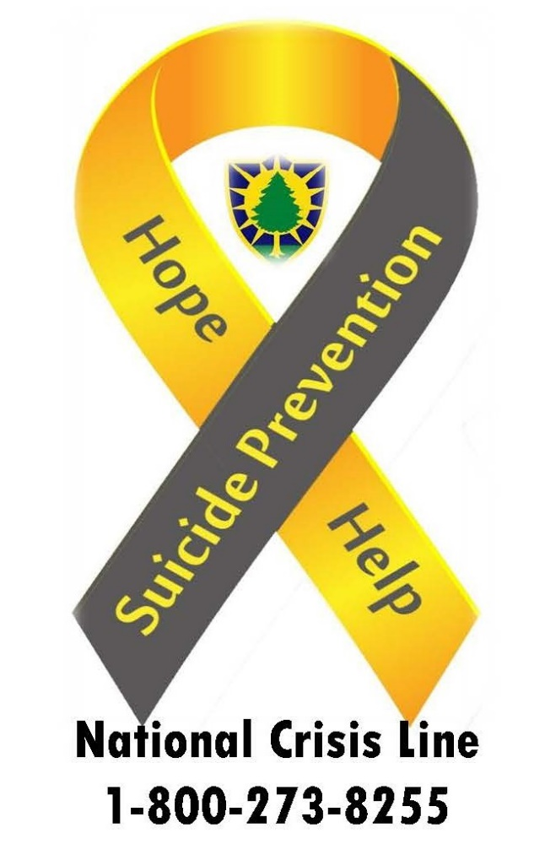
Maine Army National Guard Suicide Prevention Program
Connect To Protect
Research indicates that connectedness is a factor that can reduce the likelihood someone will consider or attempt suicide. Having social connections you can count on and a sense you belong can be a protective factor against suicide. It is important for each of us to focus on how we can connect to protect the Service Members and Military Families in our lives. Family, friends, the community, and resources all play a role in preventing suicide.
Reach out.
#BeThere
Libbi Magoon Suicide Prevention Coordinator
(207) 430-5762 libbi.a.magoon.ctr@mail.mil
Veterans Crisis Line: Suicide Prevention Hotline, Text & Chat
Support for Military Personnel & Families | Military OneSource

